Slide 1
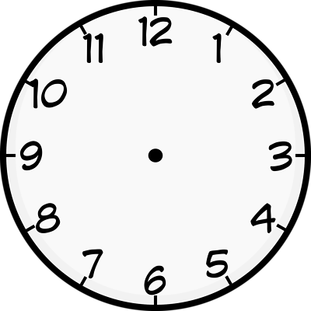
Midnight Judges
Adams and Feds lose election of 1800
They become midnight judges at the last minute.
Adams becomes 1st Lame Duck President
Adams appoints 42 Feds to judicial positions.
Feds pass Judiciary Act of 1801 to create new judicial positions.
John Marshall is appointed Chief Justice of the Supreme Court

